Slide 1



Bank Customer Churn
INFO 583 - Introduction to Data Mining for Business
Final Term Project
October 2023
Group 7
Getrude Shabiha, Hema Ravi Teja Bollam, Sarju Tuladhar

Slide 2

Introduction and Business Case
Bank Customer Churn:
Frequency with which customers leave bank or close account.
Implications:
Financial loss
Negative reputation and reduced client trust
Solution:
Decrease Bank Churn Rate

Slide 3
Objective
To decrease Bank Customer Churn.
How:
Develop the best model to predict Bank Customer Churn.
Determine key predictors that affect Customer Churn.
Who:
Bank’s Marketing Team
Bank’s Operations Team

Slide 4
Data Exploration
Date Source:
Originally collected from undisclosed European bank.
Downloaded from Kaggle:
https://www.kaggle.com/datasets/radheshyamkollipara/bank-customer-churn
Dataset Size:
10,000 records of customers
Target Variable:
Exited
1- Churned Customer 0- Not Churned Customer
Customer Attributes:
14 columns

Slide 5
Data Dictionary
Attribute | Definition
Target Variable:
Exited | Shows whether the customer has churned or not.
Customer’s Information and Demography
Surname | Second name of the customer.
Geography | Location of the given customer.
Gender | Sex of the customer.
Age | Given age of the customer.
Estimated Salary | Given income of the said customer.
Customer’s Account and Financial Information
Customer ID | Unique number given to every customer for identification.
Credit Score | Number indicating the credit worthiness of the customer
Tenure | Number of years the customer has been with the bank.
Balance | Amount of money currently in the given customer’s account.

Slide 6
Data Dictionary
Attribute | Definition
Customer’s Account and Financial Information
NumOfProducts | Number of products utilized by customer of the bank.
HasCrCard | An indication of whether the customer has been issued with a physical credit card or not.
IsActiveMember | An indication showing whether the customer is actively transacting in their account.
Complain | The number of complaints customer has raised with the bank before.
Satisfaction Score | Rating given by the customer to the bank indicating the quality of services offered.
Card Type | Level of the card that has been issued to the customer.
Points Earned | Number of awarded points that has been given to the customer for transacting with the bank.

Slide 7
Prepare data for analysis by removing and modifying data
Data Processing
Dropping Unwanted Variables
Exploring Missing Variables
Encoding Variables Dummy Coding Variables
Variables Dropped:
RowNumber
CustomerID
Surname
Complain
All the variables have 10,000 records.
Hence, there are no null values.
Encoded Variable:
Gender:
Female encoded to 0
Male encoded to 1
Dummy Coding Categorical Variables:
Geography
Card Type
Resulting Total Number of Variables for Analysis: 14 Variables

Slide 8

Churn Model Approaches, Training and Testing
Applied Models:
For our machine learning and prediction, we settled on training and testing six models namely:
Logistic Regression
KNN
Naive Bayes
Decision Tree
Random Forest
Artificial Neural Network
Deep Learning

Slide 9
Churn Model Approaches and Metrics
Model | ROC AUC | Accuracy | Precision | Recall | F1 Score
Boosted Forest | 0.85 | 0.84 | 0.88 | 0.25 | 0.39
Random Forest | 0.85 | 0.84 | 0.88 | 0.25 | 0.39
Deep Learning | 0.84 | 0.86 | 0.84 | 0.38 | 0.53
Artificial Neural Network | 0.76 | 0.81 | 0.69 | 0.20 | 0.31
Logistic Regression | 0.69 | 0.79 | 0.41 | 0.05 | 0.09
KNN Model | 0.66 | 0.79 | 0.50 | 0.01 | 0.02
Naïve Bayes | 0.54 | 0.54 | 0.24 | 0.53 | 0.33

Slide 10
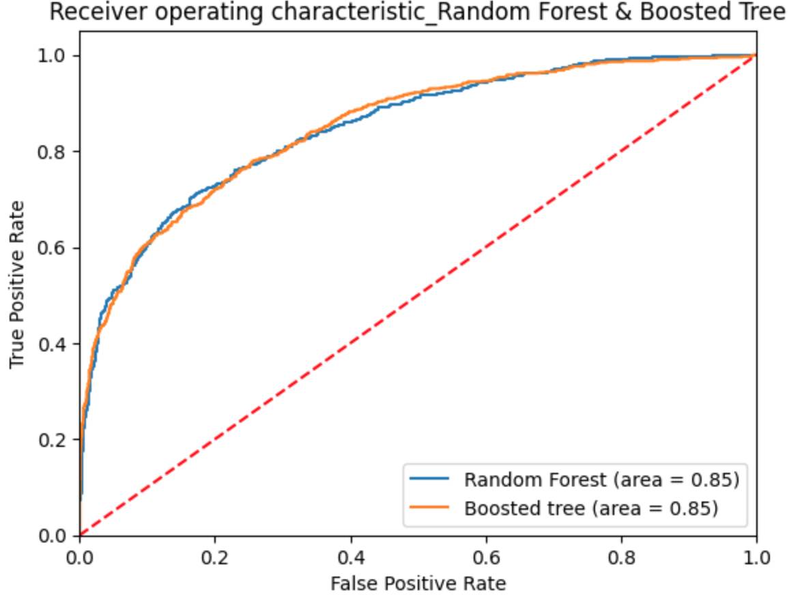
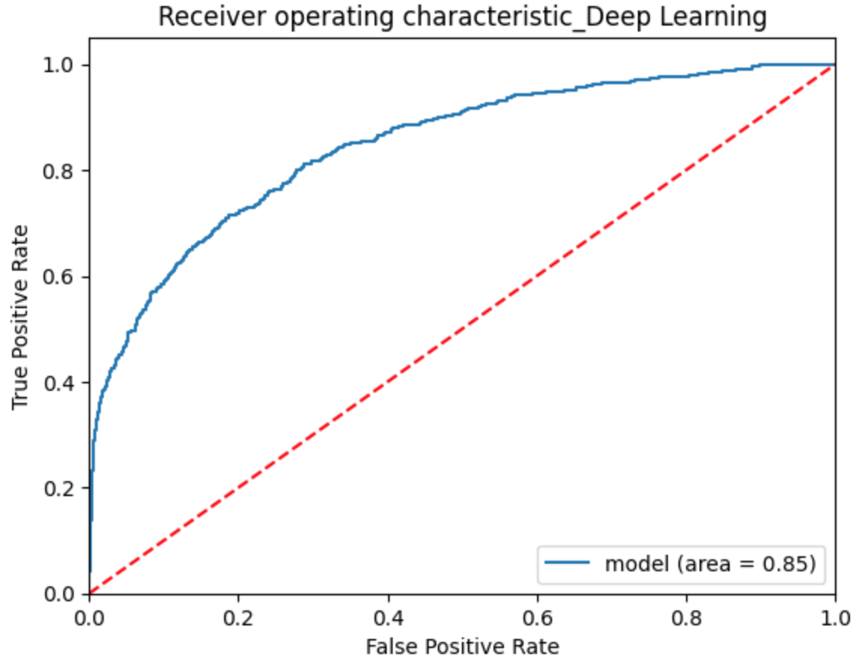
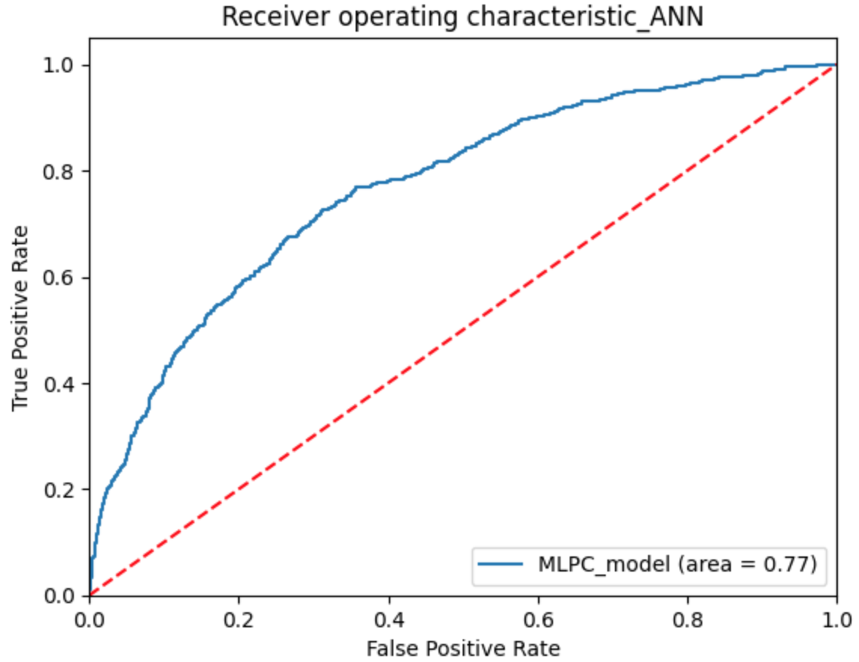
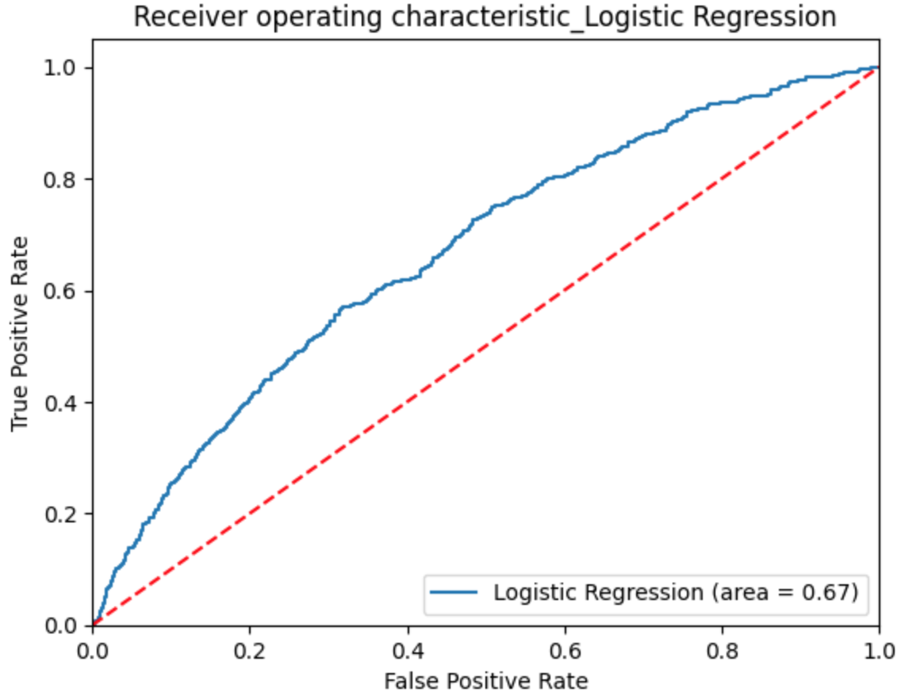
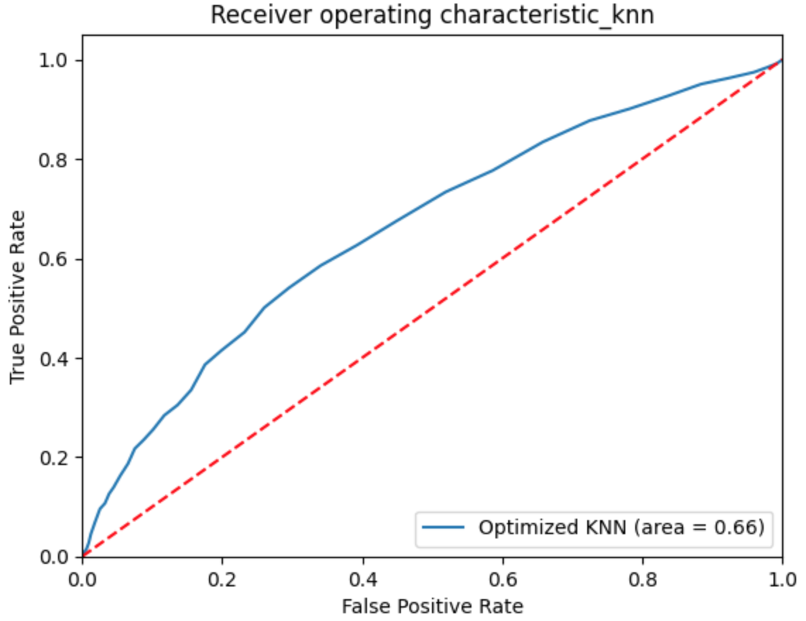
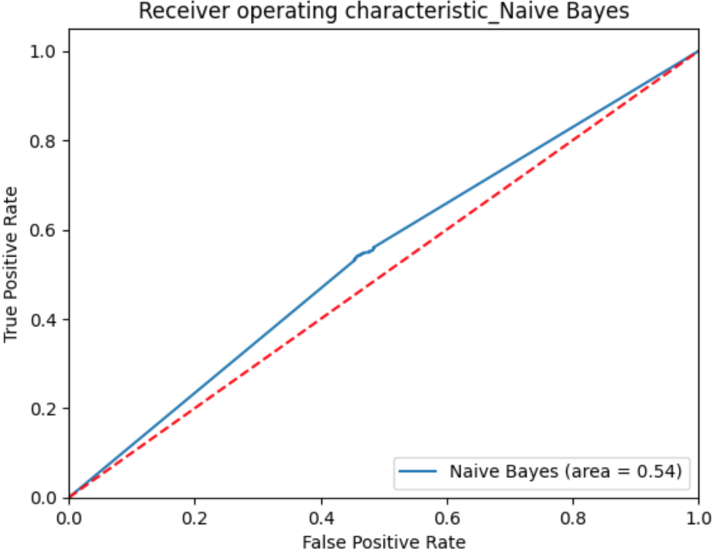
Model Selection

Slide 11
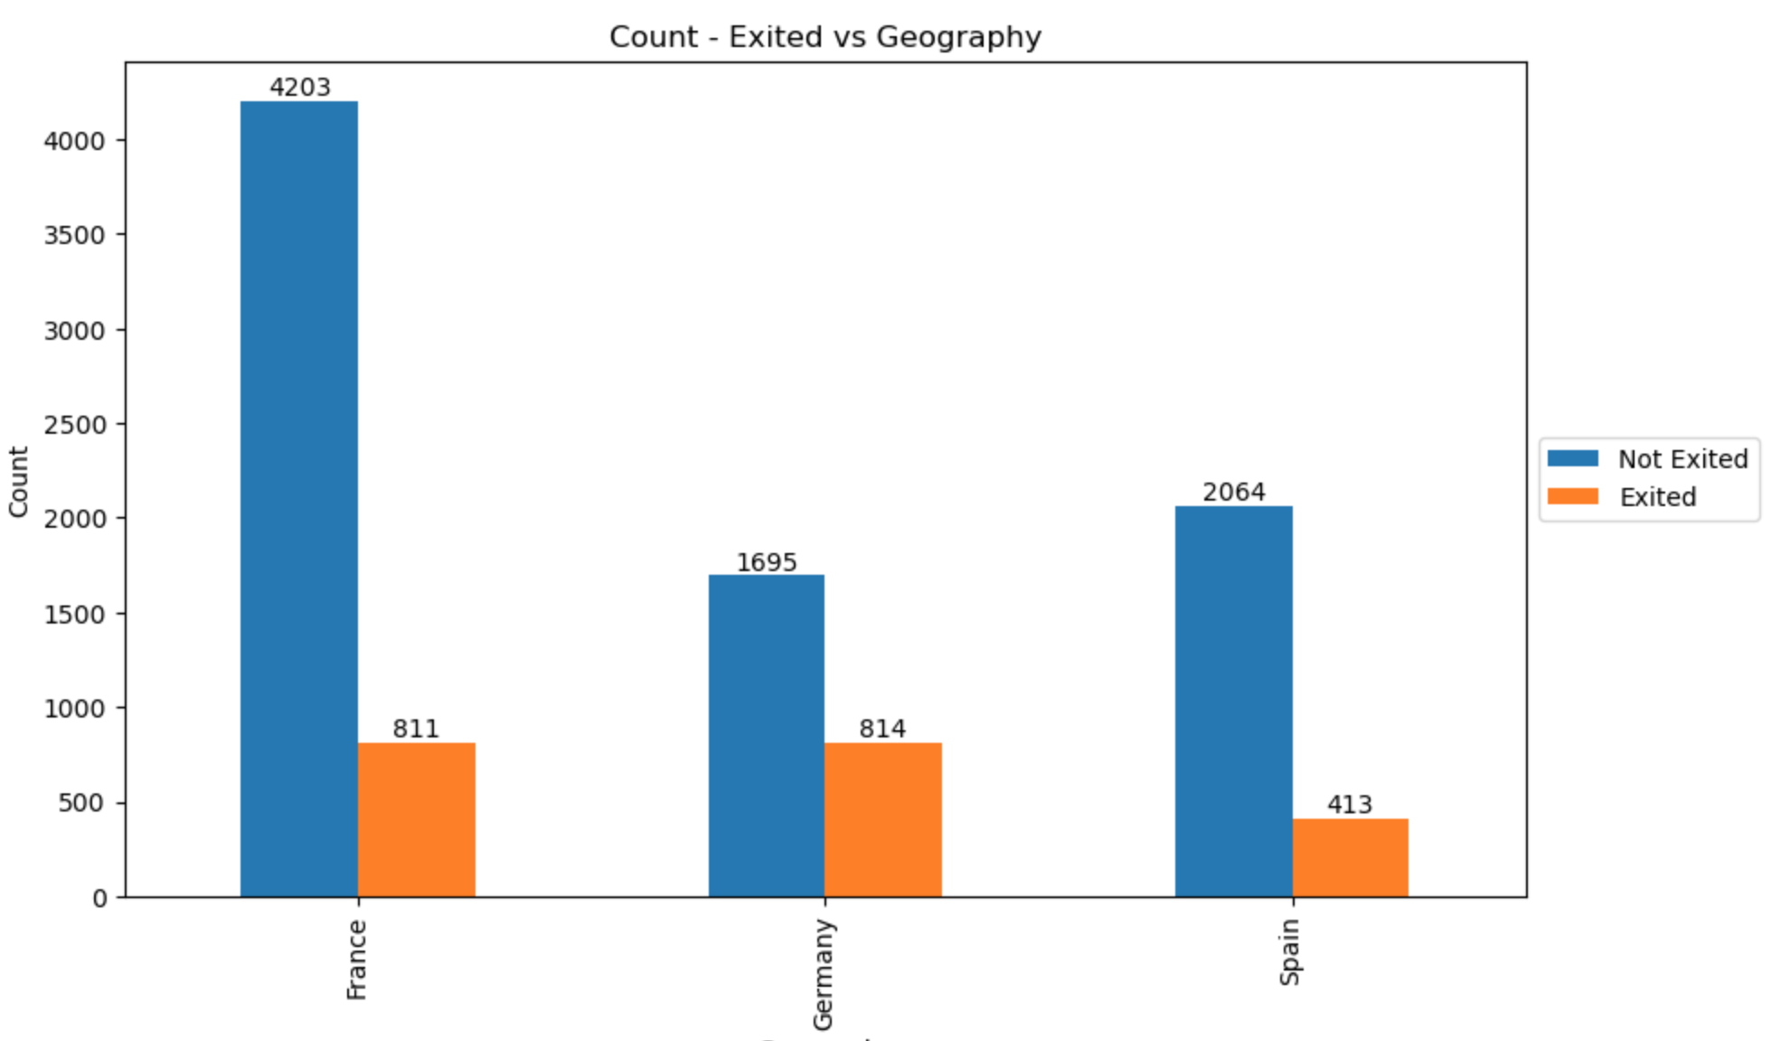
Data Visualizations and Insights of Key Predictors
Customer Churn based on Geography
Key Points
France has the least churn rate. Germany has the highest churn rate.

Slide 12
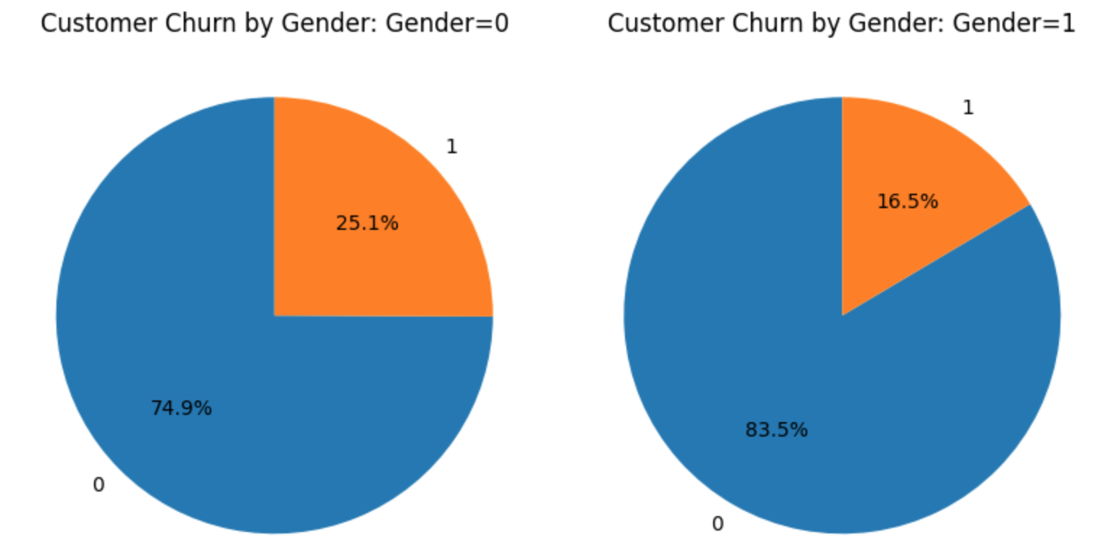
Data Visualizations and Insights of Key Predictors
Customer Churn based on Gender
Ratio of Churn for Females:
Ratio of Churn for Males:
Key Points
Female customers churn their bank account more. Male customers are more loyal.

Slide 13
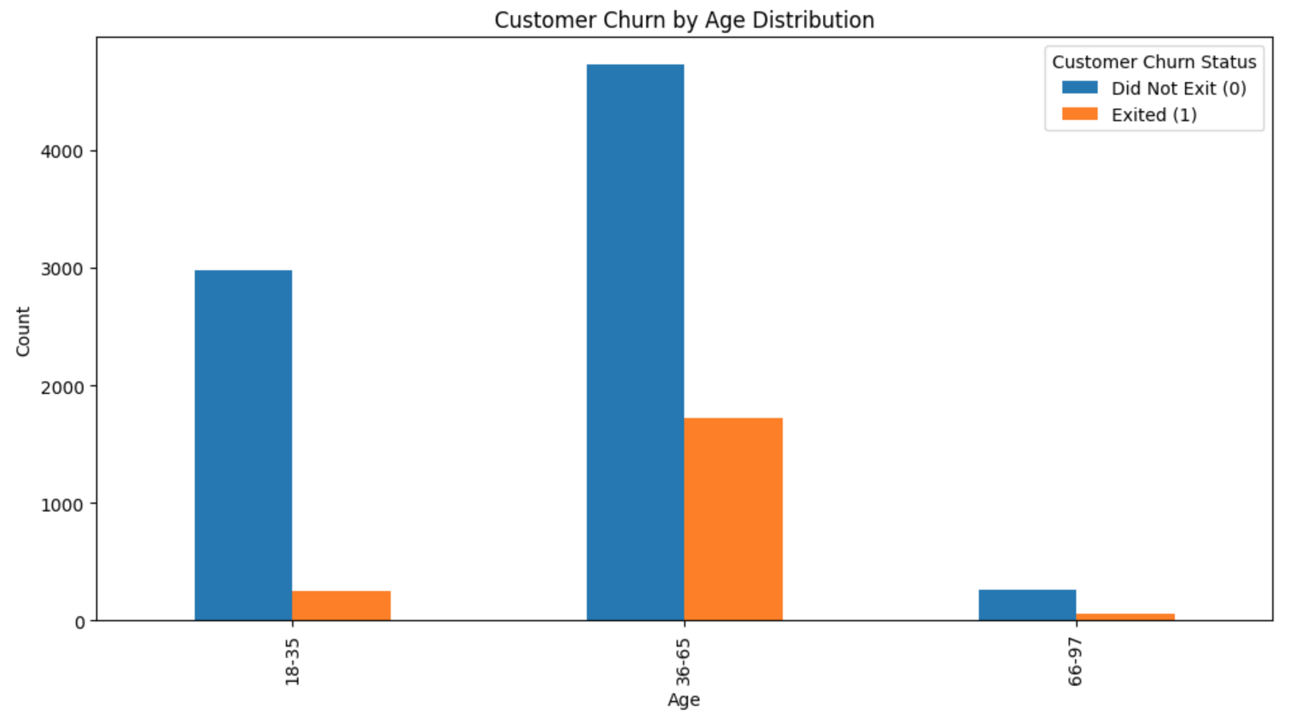
Data Visualizations and Insights of Key Predictors
Customer Churn based on Age Distribution
Key Points
Customers 35yrs or younger churn less. Customers older than 35yrs tend to churn bank account more.

Slide 14
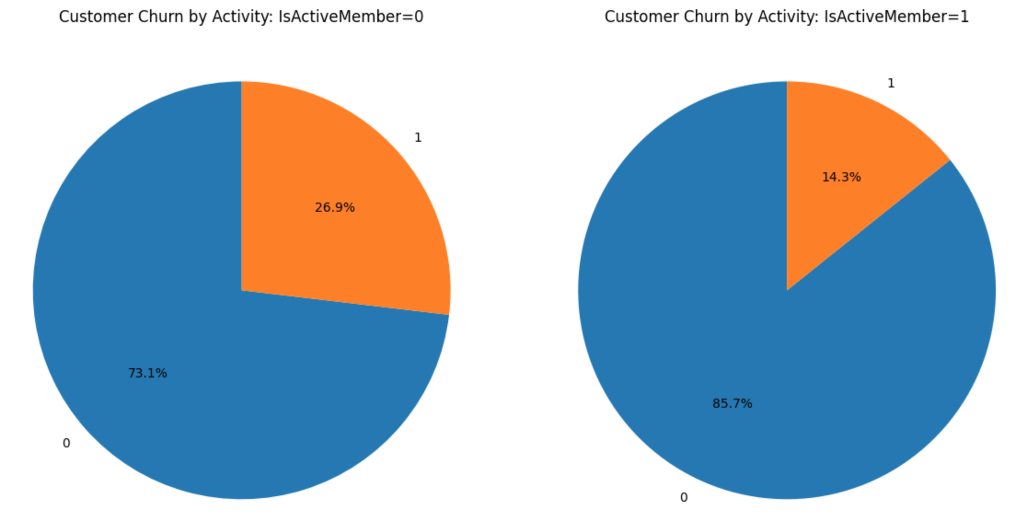
Data Visualizations and Insights of Key Predictors
Customer Churn based on Activity Status
Ratio of Churn for Inactive Members:
Ratio of Churn for Active Members:
Key Points
Inactive Customers tend to churn more. Active members tend to churn less.

Slide 15
Next Steps
Identify churning among customers
Focus on the customer that are most likely to churn and understand the reason why.
Understand Reasons for churn
Identify why customers are churning by pinpointing the main issues
Create an action plan to reduce churn
Create a marketing strategy that would reduce bringing in possible churning members and reduce churn among existing members

Slide 16
Business Recommendations: Utilize Key Predictors
Geography | Implement attractive marketing strategies to Bank customers belonging to Germany to retain more.
Gender | Introduce strategies to continue engaging Female Bank Customers.
Age Distribution | Marketing strategies like saving offers, partnering with relevant businesses might retain matured customers over 35 years.
Activity Status | Introduce new banking products or saving offers to keep engaging Customers and maintain their activity.

